Slide 1
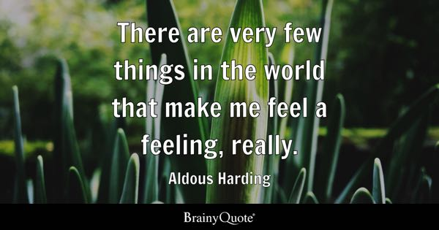

Slide 2


Slide 3
Some people are naturally not having a lot of feelings, not being so sensitive
Whereas some are taking everything so close to heart
To which group do you belong?

Slide 4
